Slide 1

EMPLOYEE DATA ANALYSIS
Using MS Excel
PSYLIQ Internship Project
Shravan Birajdar
www.linkedin.com/in/shravan-ramesh-birajdar-28a58b137

Slide 2

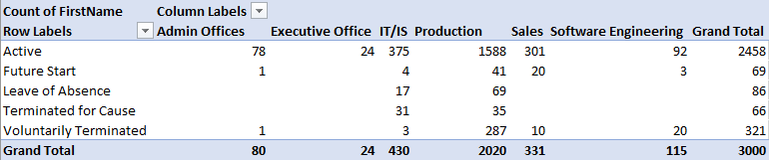
EMPLOYEE DATA ASSESSMENT
Can you create a pivot table to summarize the total number of employees in each department?

Slide 3
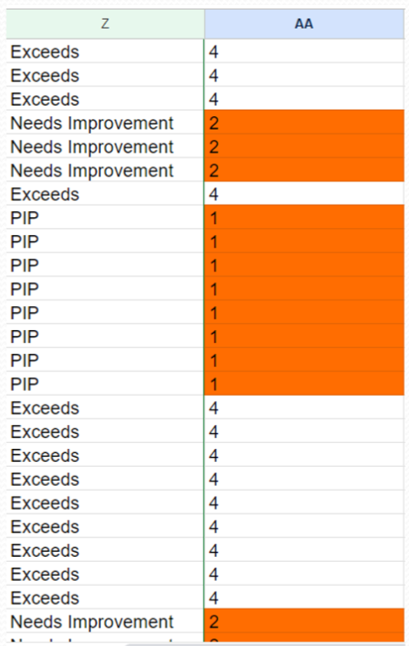
EMPLOYEE DATA ASSESSMENT
Apply conditional formatting to highlight employees with a "Performance Score" below 3 in red.

Slide 4

EMPLOYEE DATA ASSESSMENT
Calculate the average "Satisfaction Score" for male and female employees separately using a pivot table.

Slide 5
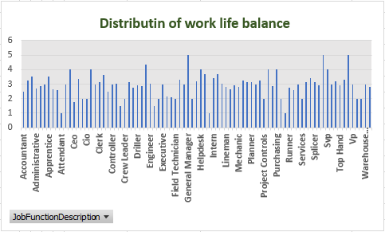
EMPLOYEE DATA ASSESSMENT
Create a chart to visualize the distribution of "Work-Life Balance Score" for different job functions.

Slide 6
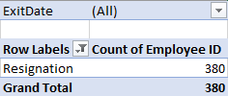
EMPLOYEE DATA ASSESSMENT
Filter the data to display only terminated employees and find out the most common "Termination Type."

Slide 7
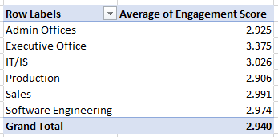
EMPLOYEE DATA ASSESSMENT
Calculate the average "Engagement Score" for each department using a pivot table.

Slide 8
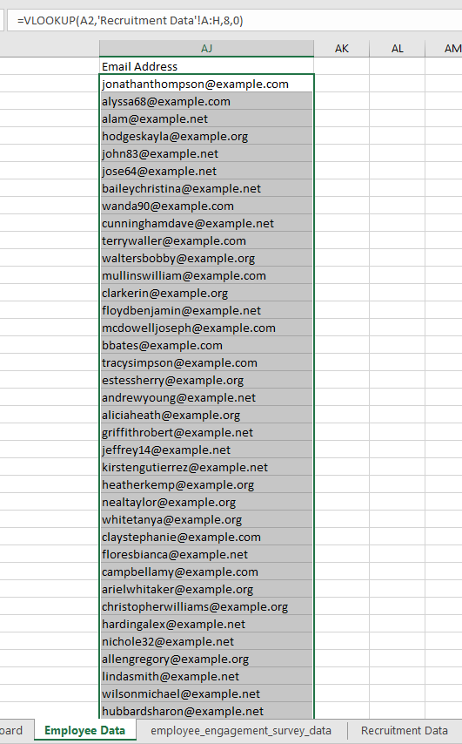
EMPLOYEE DATA ASSESSMENT
Use VLOOKUP to find the supervisor's email address for a specific employee.

Slide 9

EMPLOYEE DATA ASSESSMENT
Can you identify the department with the highest average "Employee Rating?"

Slide 10
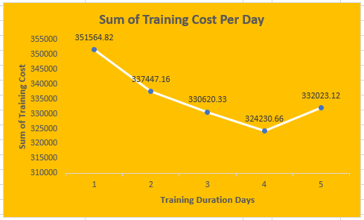
EMPLOYEE DATA ASSESSMENT
Create a scatter plot to explore the relationship between "Training Duration (Days)" and "Training Cost."

Slide 11
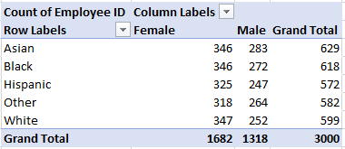
EMPLOYEE DATA ASSESSMENT
Build a pivot table that shows the count of employees by "RaceDesc" and "GenderCode."

Slide 12
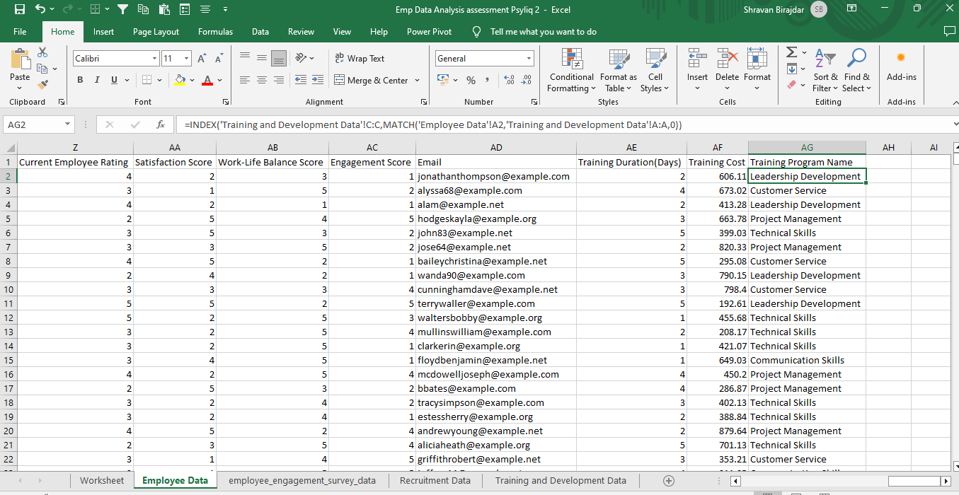
EMPLOYEE DATA ASSESSMENT
Use INDEX and MATCH functions to find the "Training Program Name" for an employee with a specific ID.

Slide 13
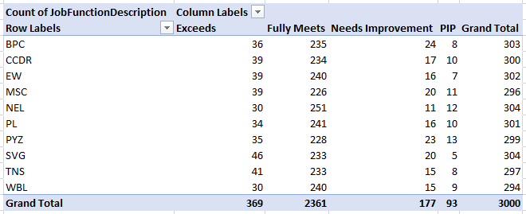
EMPLOYEE DATA ASSESSMENT
Create a multi-level pivot table to analyze the "Performance Score" by "BusinessUnit" and "JobFunctionDescription."

Slide 14
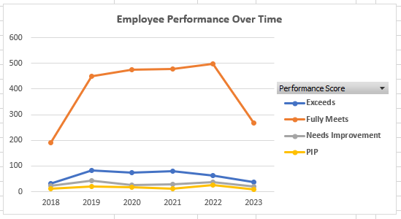
EMPLOYEE DATA ASSESSMENT
Design a dynamic chart that allows users to select and visualize the performance of any employee over time.

Slide 15
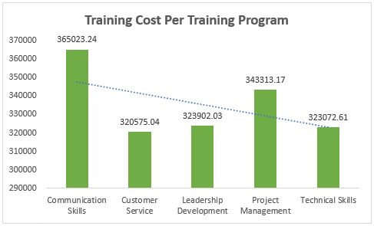
EMPLOYEE DATA ASSESSMENT
Calculate the total training cost for each "Training Program Name" and display it in a bar chart.

Slide 16
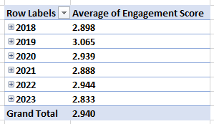
EMPLOYEE DATA ASSESSMENT
Use a calculated field in a pivot table to determine the average "Engagement Score" per year.

Slide 17
EMPLOYEE DATA ASSESSMENT
Create a histogram to understand the distribution of "ExitDate" for terminated employees.

Slide 18
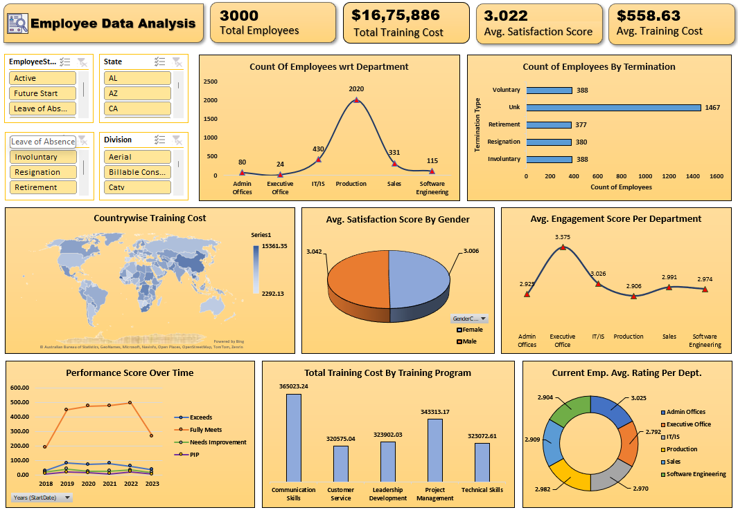
Develop a dashboard that provides an overview of key HR metrics, including headcount, performance, and training costs, using charts and pivot tables.

Slide 19
Thank You…
Shravan Birajdar Data Analyst Intern at PSYLIQ

